Slide 1
UNIT-6
Ruby and Rails

Slide 2
Origins & uses of Ruby
Ruby is a pure object-oriented open-source programming language.
It is also referred to as scripting language that is dynamic and interpreted.
It supports cross-platform operating systems and was written in C language.
Ruby has a syntax that is mainly similar to Perl and Python.
It is scalable and projects with large code are easily maintainable.

Slide 3
Uses of Ruby:
Object Creation:
Since everything in Ruby is an object, every object can have its own unique properties and methods. This makes evaluating code easier and more customizable.
2. Dynamic Typing:
Dynamic typing means that the data type of variable you are using can be changed and resolved on the fly, allowing for much easier and useful adaptation in the later stages of a project.
Code Quality:
Ruby is particularly known for the intuitive elements of its code that make it easy for developers to maintain and understand.
This not only allows the code run more quickly, but it also reduces the burden on programmers significantly than some other languages when finding and solving bugs.

Slide 4
4. Efficiency:
Ruby’s simplicity and flexibility at various stages in a project makes it much easier to manipulate, making it a low-cost alternative to developing a dynamic web application.
This is key for businesses and startups working with limited budgets on ideas that require complex features and frameworks for operations.
5. Community Support:
Ruby has a great community which is very active, optimist and large.
The community provides every possible help to the developers. It supports the new developers to learn with help of available material

Slide 5
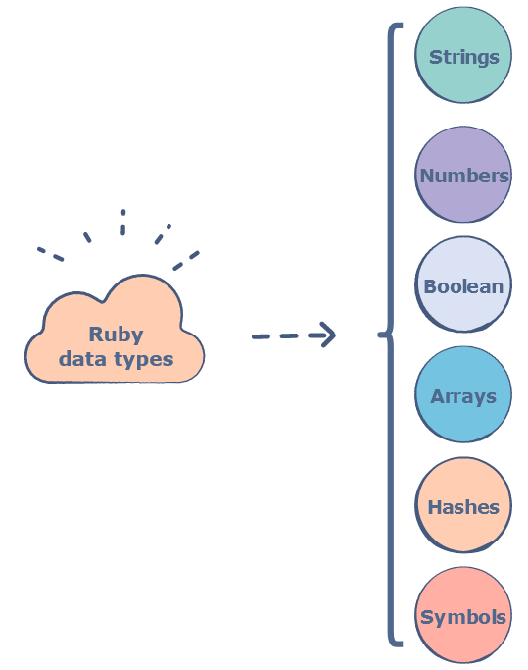
Data types in Ruby and their operations
Data types in Ruby represent different categories of data such as text, string, numbers, etc.
Since Ruby is an object-oriented language, all its supported data types are implemented as classes.

Slide 6
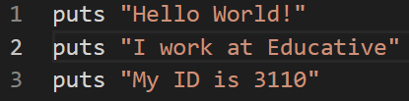
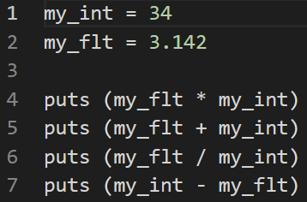
Strings: A string is made up of multiple characters. They are defined by enclosing a set of characters within single (‘xyz’) or double (“xyz”) quotes.
Numbers: A number is a series of digits that use a dot as a decimal mark (where ever required). Integers and floats are the two main kinds of numbers that Ruby can handle.

Slide 7
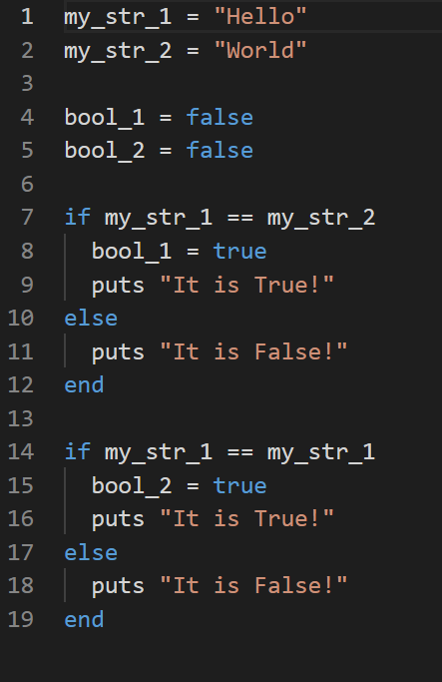
Booleans:
The Boolean data type represents only one bit of information that says whether the value is true or false.
Generally, a value of this data type is returned when two values are compared.

Slide 8
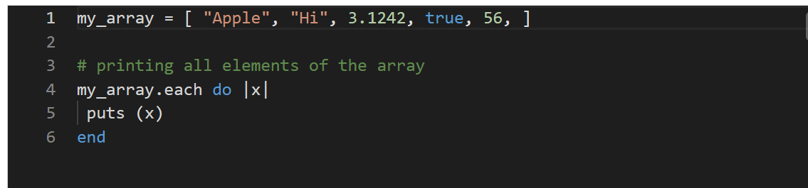
Arrays:
An array can store multiple data items of all types. Items in an array are separated by a comma in-between them and enclosed within square brackets.
The first item of the array has an index of 0.
Ruby arrays grow automatically while adding elements to them.
Another way is with the new class method :
names = Array.new(20)
puts names.size # This returns 20
puts names.length # This also returns 20

Slide 9
Fundamentals of arrays
Ruby arrays are ordered, integer-indexed collections of any object.
Each element in an array is associated with and referred to by an index.
Array indexing starts at 0, as in C or Java.
A negative index is assumed relative to the end of the array, i.e. an index of -1 indicates the last element of the array, -2 is the next to last element in the array, and so on.
Ruby arrays can hold objects such as String, Integer, Hash, Symbol, even other Array objects.
Ruby arrays are not as rigid as arrays in other languages.

Slide 10
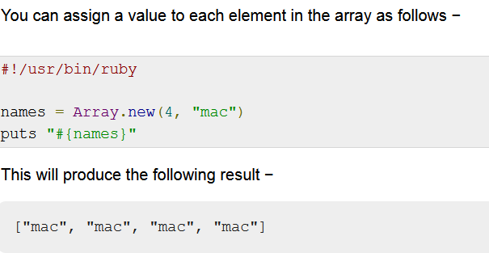

Slide 11
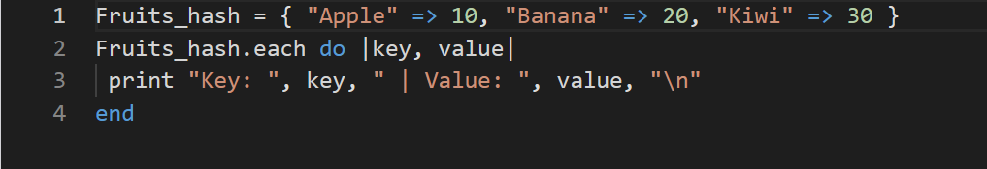
Hashes
A hash stores key-value pairs.
Assigning a value to a key is done by using the => sign.
Key-value pairs are separated by commas and all the pairs are enclosed within curly braces.

Slide 12
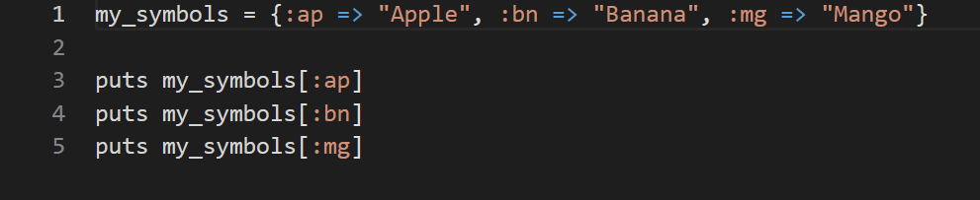
Symbols
Symbols are a lighter form of strings.
They are preceded by a colon (:) and used instead of strings because they take up less memory space and have a​ better performance.

Slide 13
Operators
Ruby supports a rich set of operators and most operators are actually method calls.
For example, a + b is interpreted as a.+(b), where the + method in the object referred to by variable a is called with b as its argument.
For each operator (+ - * / % ** & | ^ << >> && ||), there is a corresponding form of abbreviated assignment operator (+=, -=, etc.)

Slide 14
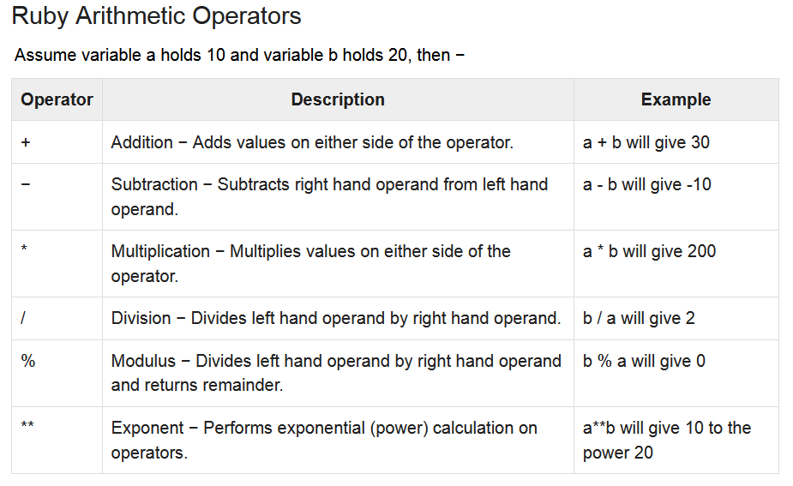

Slide 15
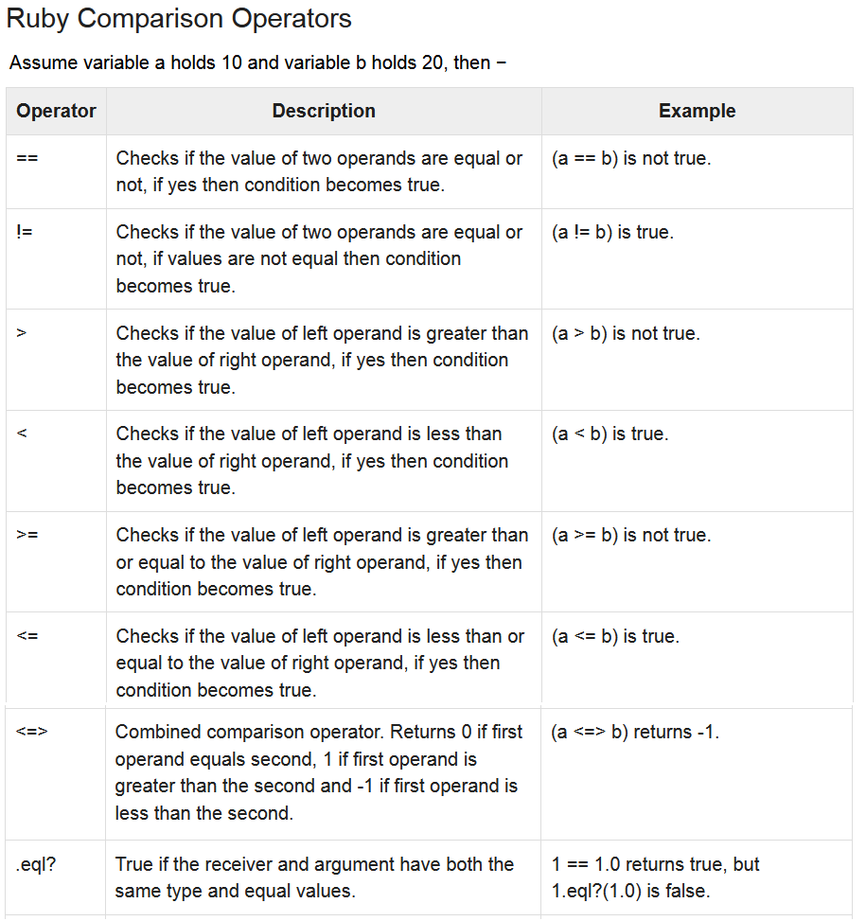

Slide 16
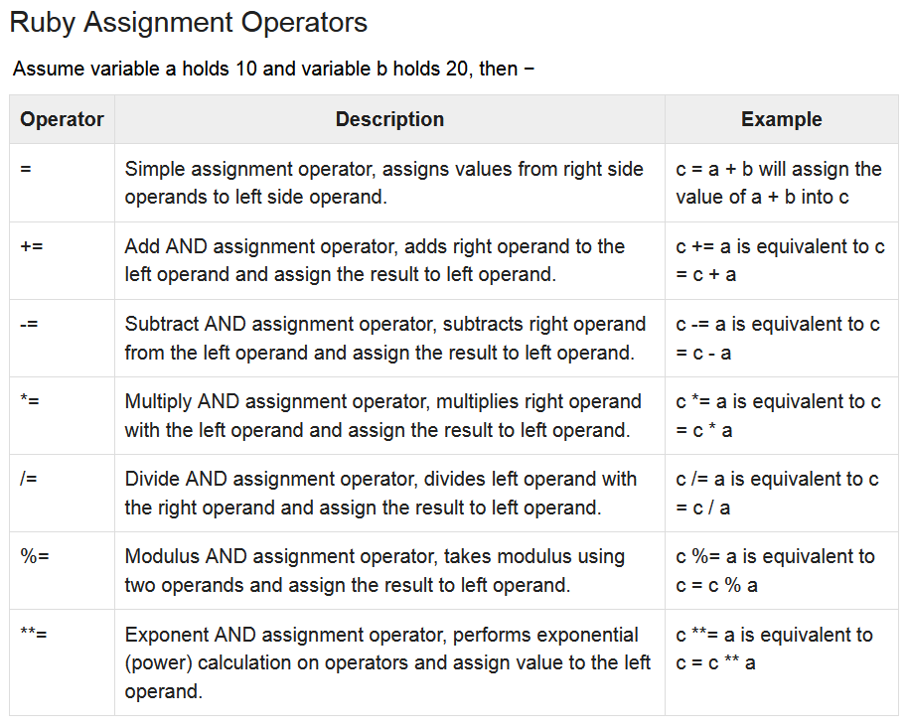

Slide 17
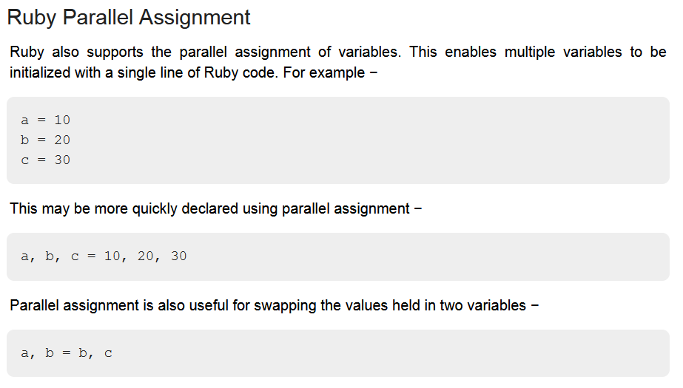

Slide 18
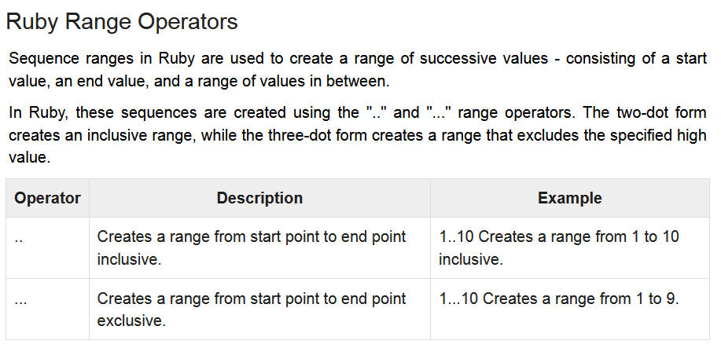

Slide 19
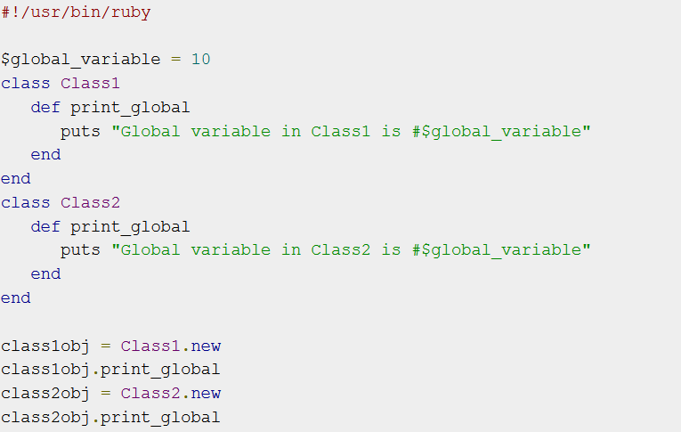
Ruby Global Variables
Global variables begin with $.

Slide 20
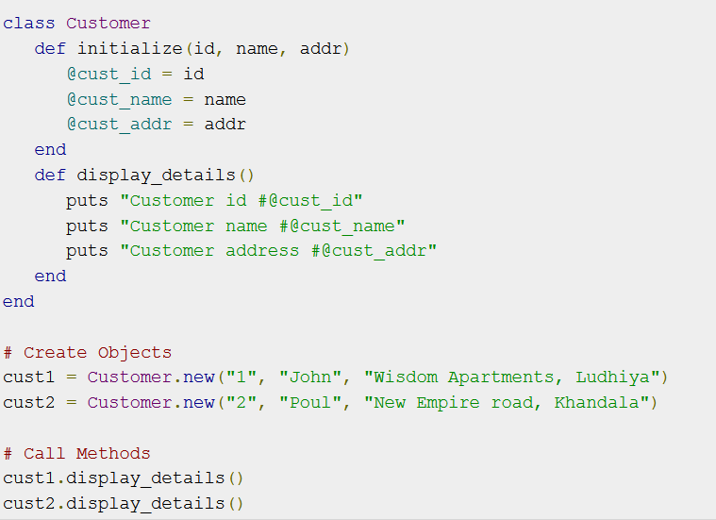
Ruby Instance Variables
Instance variables begin with @

Slide 21
Ruby Class Variables
Class variables begin with @@ and must be initialized before they can be used in method definitions.
Referencing an uninitialized class variable produces an error.
Class variables are shared among descendants of the class or module in which the class variables are defined.

Slide 22
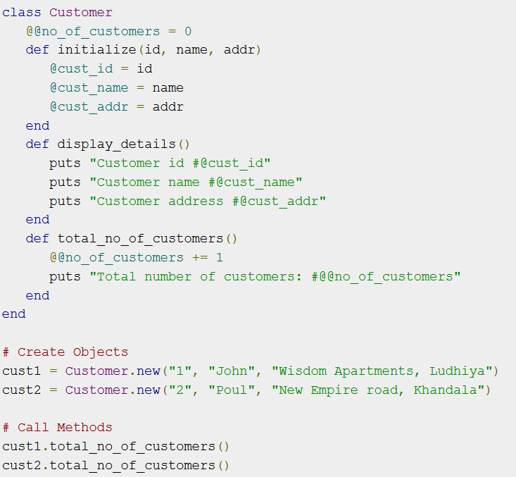

Slide 23
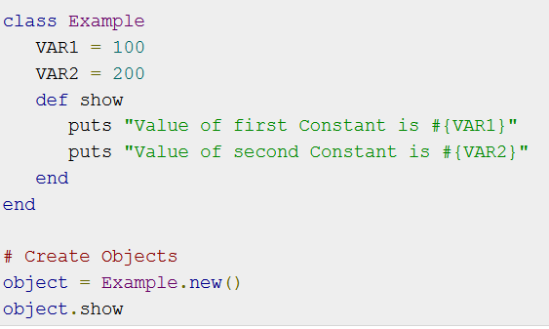
Ruby Constants
Constants begin with an uppercase letter.
Constants defined within a class or module can be accessed from within that class or module, and those defined outside a class or module can be accessed globally.

Slide 24
Input/ Output in Ruby
All ruby files will have extension .rb
We can use puts or print functions for displaying output in Ruby
puts "Hello, Ruby!";
To run the program −
$ ruby test.rb
A comment hides a line, part of a line or several lines from the Ruby interpreter by using the hash character (#) :
# This is a comment.
name = "Madisetti" # This is again comment
# This is a comment, too.

Slide 25
To take input from user we can use gets method.
gets function takes input from the keyboard in string format and stores the value in the variables.
name = gets
This statement takes a string input from the user and stores it in the variable called name.
It also appends a \n new line character at the end of the input entered by the user.
To check, if you display using print function, it displays the text entered by the user along with a new line.
To remove the newline, you can use a function called chomp.
print name.chomp

Slide 26
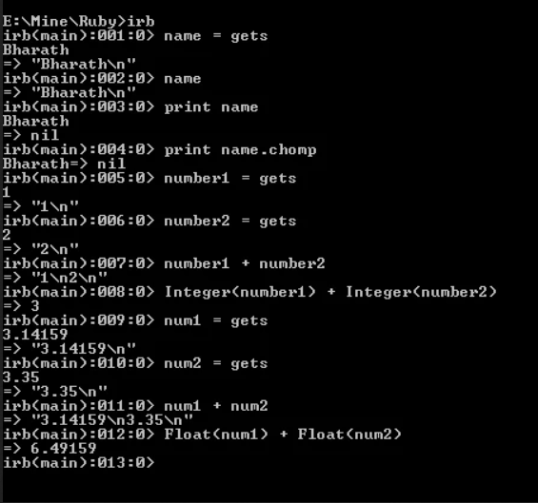

Slide 27
Since gets method takes input in string format so, conversion to whole number is required before any arithmetic operations could be performed on the data.
This can be done using integer(), float() functions.
If the conversion is not done, it simply performs the concatenation operation.

Slide 28
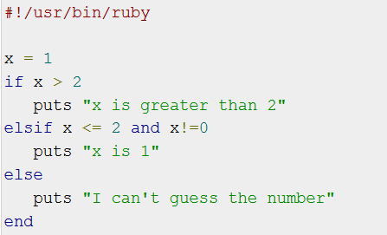
Ruby if...else Statement
An if expression's conditional part is separated from code by the reserved word then, a newline, or a semicolon.

Slide 29
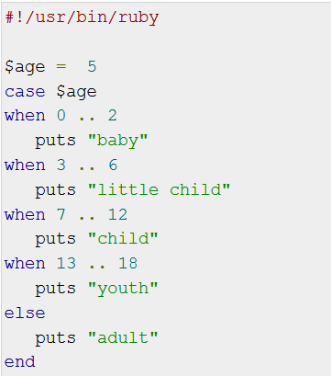
Ruby case Statement
Compares the expression specified by case and that specified by when and executes the code of the when clause that matches.
A when statement's expression is separated from code by the reserved word then, a newline, or a semicolon

Slide 30
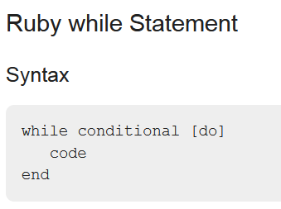
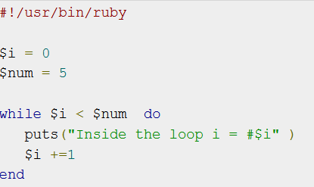
A while loop's conditional part is separated from code by the reserved word do, a newline, backslash \, or a semicolon ;

Slide 31
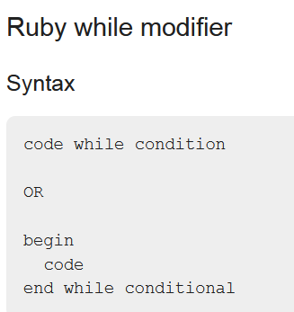
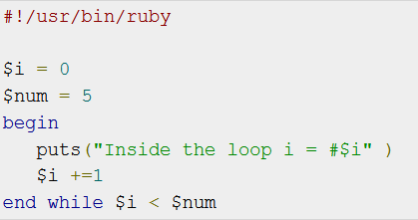
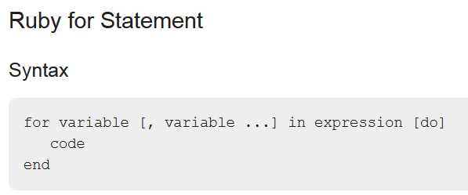
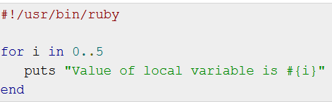

Slide 32
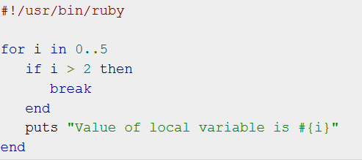

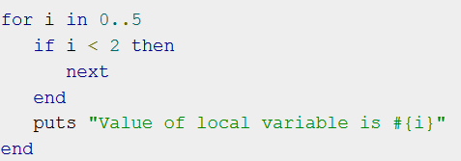
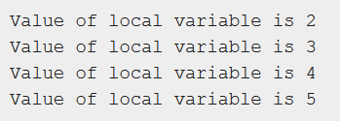
Ruby break and next Statements
break terminates the most internal loop.
next makes jump to the next iteration of the most internal loop.

Slide 33
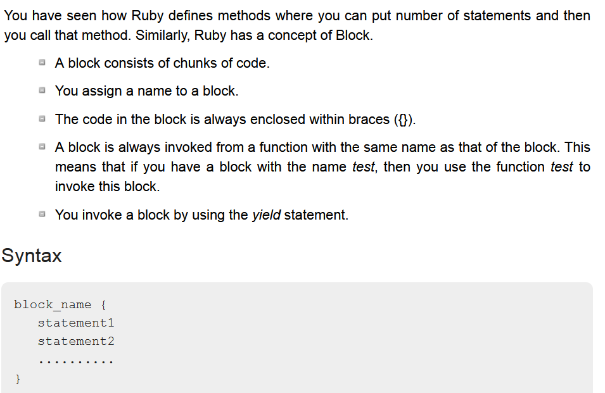
Ruby blocks

Slide 34
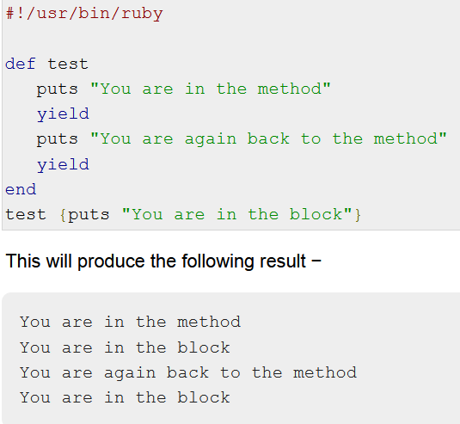
A block is invoked by using a simple yield statement.

Slide 35
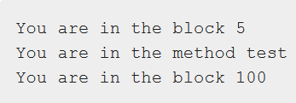
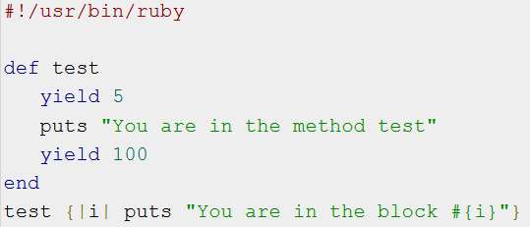
You also can pass parameters with the yield statement.
In the block, a variable between two vertical lines (||) is placed to accept the parameters.
You can even pass more than one parameter in comma separated way.

Slide 36
Iterators
Iterators are nothing but methods supported by collections.
Objects that store a group of data members are called collections.
In Ruby, arrays and hashes can be termed collections.
Iterators return all the elements of a collection, one after the other.
There are two iterators in Ruby, each and collect.

Slide 37
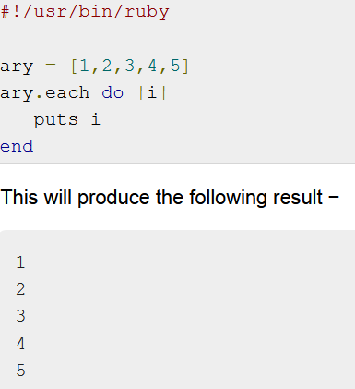
Ruby each Iterator
The each iterator returns all the elements of an array or a hash, but one at a time.
You always associate the each iterator with a block.
It returns each value of the array, one by one to the block.
The value is stored in the variable i and then displayed on the screen.

Slide 38
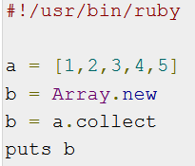
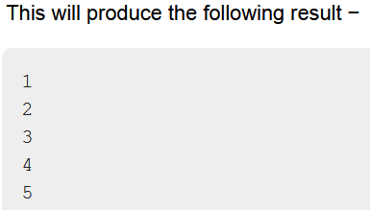
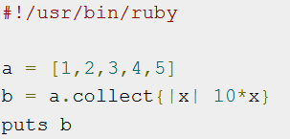
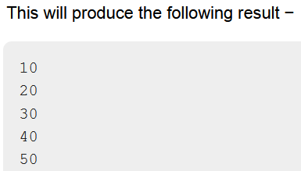
Ruby collect Iterator
The collect method returns the entire collection at once, regardless of whether it is an array or a hash.
We normally use the collect method when you want to do something with each of the values to get a new array.
For example, an array b containing 10 times each value in a.

Slide 39
Introduction to Rails

Slide 40
Rails framework
Ruby on Rails or also known as rails is a server-side web application development framework that is written in the Ruby programming language
It supports MVC (model-view-controller) architecture that provides a default structure for database, web pages, and web services.
It also uses web standards like JSON or XML for transfer data and HTML, CSS and JavaScript for the user interface.

Slide 41
Feature of Ruby on Rails
Most of the languages like Java, HTML, CSS, etc. do not cover the front end and back end both.
They are either only for the back end or for the front end but, Ruby on Rails is used for both front end & back end, it is like a complete package to develop a web application.

Slide 42
1. Model-view-controller Architecture:
MVC is generally used for developing user interfaces that divide the data into three interconnected components, so that it can separate the internal representation of the information from the way it is presented to and got from the user.
2. Built-in Testing: Ruby on Rails provides its own set of tests that will run on your code. It will save time and effort.
3. Libraries: There’s a 3rd party module for just about anything we can think of.
4. Large Community: Ruby is large in the community.
5. Code Quality: Ruby’s code quality is significantly higher than PHP or NodeJS equivalents.

Slide 43
Rails Database
Rails comes with built-in support for SQLite, which is a lightweight server-less database application.
A busy production environment may overload SQLite, but it works well for development and testing.
Rails by default uses a SQLite database when creating a new project, but you can always change it later.

Slide 44
Ruby on Rails recommends to create three databases - a database each for development, testing, and production environment.
According to convention, their names should be −
library_development
library_production
library_test
Then, it is required to configure database.yml, so as to let Rails know about the user name and password for the databases.
The file database.yml is available in the library\config subdirectory of any Rails Application you created.

Slide 45
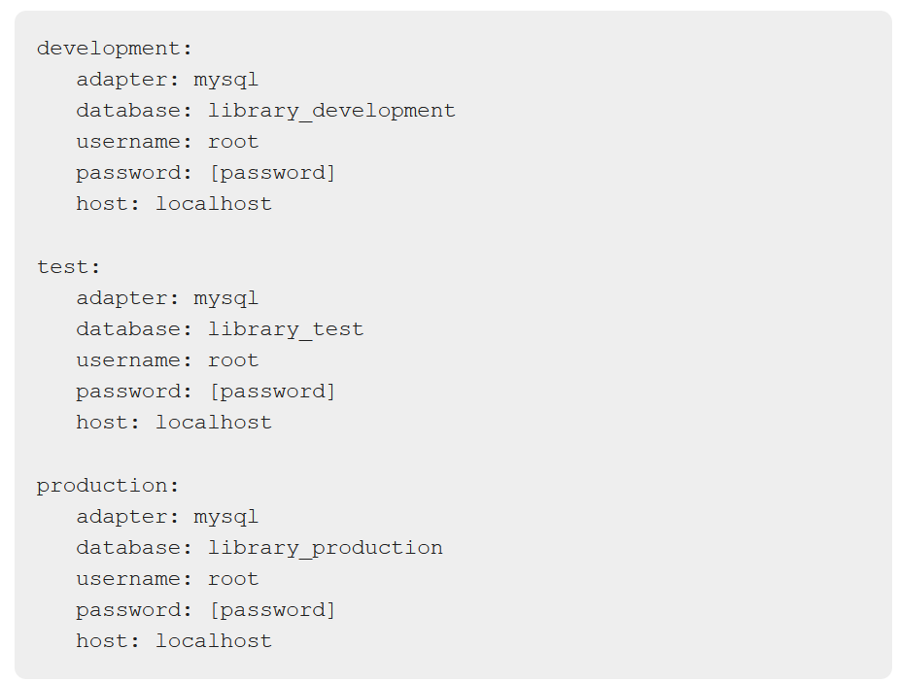

Slide 46
Ruby on Rails MVC Framework
The Model View Controller principle divides the work of an application into three separate but closely cooperative subsystems.
Model (ActiveRecord ):
It maintains the relationship between the objects and the database
This subsystem is implemented in ActiveRecord library, which provides an interface between the tables in a relational database and the Ruby program code that manipulates database records.
Ruby method names are automatically generated from the field names of database tables.

Slide 47
View ( ActionView ):
It is a presentation of data in a particular format, triggered by a controller's decision to present the data.
They are script-based template systems like JSP, ASP, PHP
This subsystem is implemented in ActionView library, which is an Embedded Ruby (ERb) based system for defining presentation templates for data presentation

Slide 48
Controller ( ActionController ):
The controller in a way directs the data traffic.
On one hand, it queries the models for specific data, and on the other hand, organizes that data (searching, sorting, messaging it) into a form that fits the needs of a given view.
This subsystem is implemented in ActionController, which is a data broker sitting between ActiveRecord (the database interface) and ActionView (the presentation engine).

Slide 49
Layouts
A layout defines the surroundings of an HTML page. It's the place to define a common look and feel of your final output.
Layout files reside in app/views/layouts.
The process involves defining a layout template and then letting the controller know that it exists and to use it.

Slide 50
Enterprise Java Beans (EJB)
EJB provides an architecture to develop and deploy component based enterprise applications based on Java technology considering robustness, high scalability and high performance.
When to use Enterprise Java Bean?
Application needs Remote Access: EJB application is distributed.
Application needs to be scalable: EJB applications supports load balancing, clustering and fail-over.
Application needs encapsulated business logic: EJB application is separated from presentation and persistent layer.
EJB Tutorial: https://youtu.be/LG0pD6uHy3U

